Slide 1



A General Framework for Fast 3D Object Detection
and Localization Using an Uncalibrated Camera
Authors: Andres Solis Montero, Jochen Lang, and Robert Laganiere
University of Ottawa
School of Electrical Engineering and Computer Science
VIVA Lab

Slide 2
Problem & Objectives
Problem
Visual real-time 3D object detection
Mobile camera independent of camera optics and mobile object
Memory constraints and no 3D model of the object
Objectives
Real-time single camera video-based application:
detects moving objects from an uncalibrated mobile camera
has small memory footprint
is invariant to viewpoint changes, robust to noise and image illumation changes
accounts for occlusions and cluttered environments

Slide 3
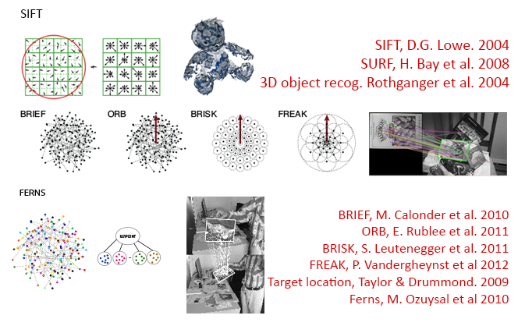
Related Work
Notes:
Feature-based object detection has been widely studied for planar and 3d objects.
Increased feature representation and descriptors have been introduced and implemented in object detection solutions.
Gradient based solutions like SIFT, SURF, HOG are computationally expensive and somehow memory savvy.
Binary descriptors trade some matching quality with speed. Lower memory consumption.
Classifiers, are the balance between of high performance and fast speed but they increase the memory footprint and add an off-line training phase.
In the case of Ferns, memory usage is exponential in the size of the Ferns.
The main goal was to reduce the memory footprint while acquiring high matching performance compared to Gradient based and Classifiers.
We also wanted to benefit from the use of strong invariant features and descriptors.

Slide 4
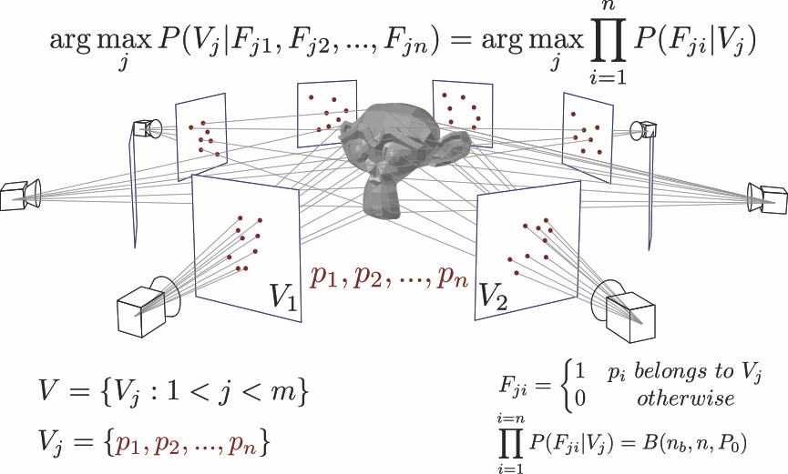
Details
Notes:
Naïve Bayes classifier for view matching and keypoint classifier. The object is matched against the closest view in the database model.
The view is selected as the maximum likelihood problem of selecting a view giving a keypoint set observation.
Each view is learn by applying artificially transformations. At each transformation the most stable keypoints are selected and back-projected to the initial frame.
For each point in the initial frame we will create a set of binary descriptors that we will combine using our classifier.
Our classifier encodes the probability of the ith-bit to appear for each feature as a log Probability. (This is used for stability of the Naives Bayes Classifier and for added performance).

Slide 5
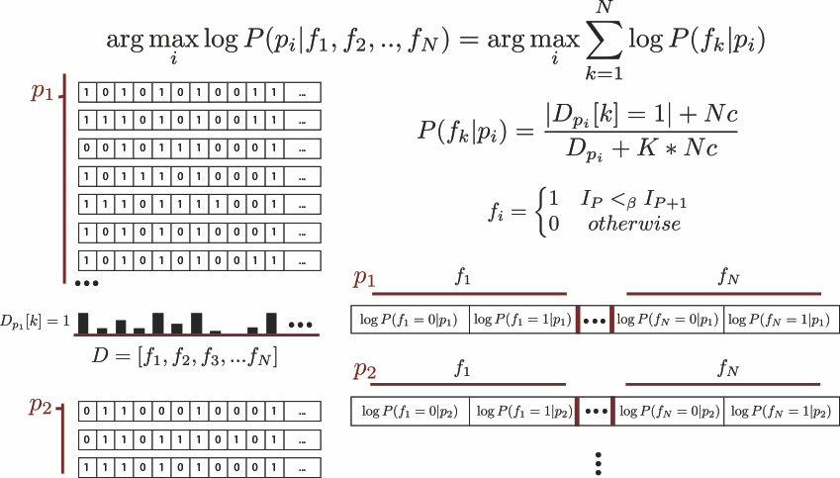
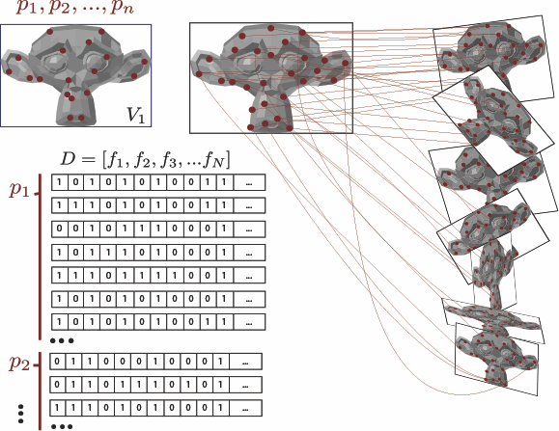
Details
Notes:
Naïve Bayes classifier for view matching and keypoint classifier. The object is matched against the closest view in the database model.
The view is selected as the maximum likelihood problem of selecting a view giving a keypoint set observation.
Each view is learn by applying artificially transformations. At each transformation the most stable keypoints are selected and back-projected to the initial frame.
For each point in the initial frame we will create a set of binary descriptors that we will combine using our classifier.
Our classifier encodes the probability of the ith-bit to appear for each feature as a log Probability. (This is used for stability of the Naives Bayes Classifier and for added performance).

Slide 6

Experimental Results
Notes:
First part of video: MousePad Ferns
Second part: Mousepad our framework
Thrid part: more examples

Slide 7
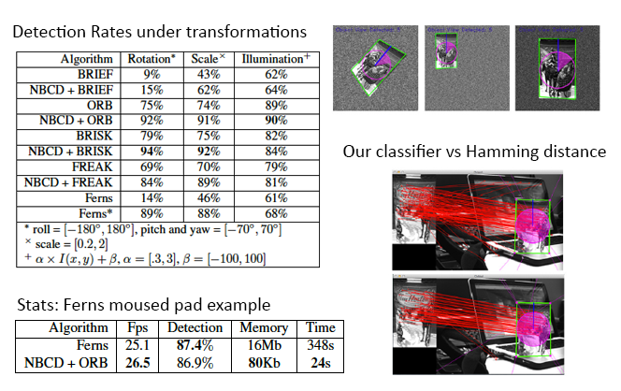
Experimental Results
Notes:
First table is the result of our synthetic evaluation using rotation, scale, and illumination changes. (objects were also randomly positioned)
Three images example of randomly synthetic transformations.
Second table is the comparison between ferns and our NBCD using ORBS.
Detection rate appears in the “Detection” row.
The “Memory” row is the memory usage by both solutions.
The ‘Time’ row means the Learning/Training time to construct the model in seconds.
Our classifier vs Hamming distance example
Shows how our classifier makes a better matching scheme compared to the hamming distance.
Both sets of matching (above and below) have the same hamming distance but our classifier is more accurate (lessoutliers).
Ferns behaved similar (same amount of inliers/ outlier) to our solution so it was not showed.

Slide 8
Contributions & Conclusions
Framework for real-time 3D object detection using a single, mobile and uncalibrated camera
Combine binary descriptors with Naïve Bayes classifiers for feature classification and matching
The new classifier exploits the specific structure of binary descriptors to increase feature matching while conserving descriptor properties
Small memory footprint due to efficiently encoded features
Learning time is reduced because invariant features and descriptors
Improved indexing scheme to speed up keypoing matching

